Slide 1
Preparatory Action on Smart Rural Areas of the 21st Century
Call for villages/communities to candidate for smart village program
Kristiina Tammets, Estonian national expert for the project

Slide 2
What is project about?
The ‘Smart Rural’ project is a two and a half-year project supported by the European Commission (DG AGRI) with the overall aim to promote and inspire villages to develop and implement smart village approaches and strategies across Europe, and to draw conclusions and support future CAP interventions on smart villages.
17 villages are selected across Europe to receive guidance and technical support through the project. 5 villages have already been selected in Ireland, Finland, France, the Czech Republic and Greece, and further 12 villages will be selected until 30 April 2020.

Slide 3
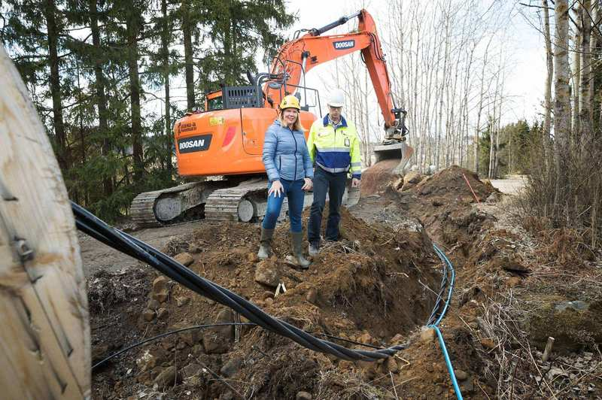
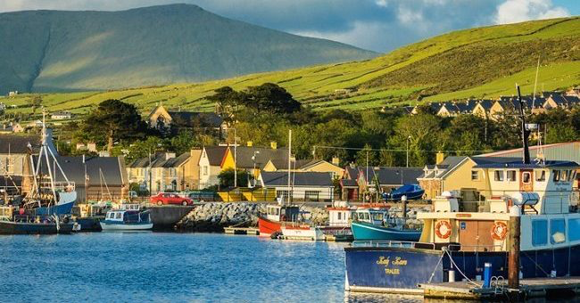
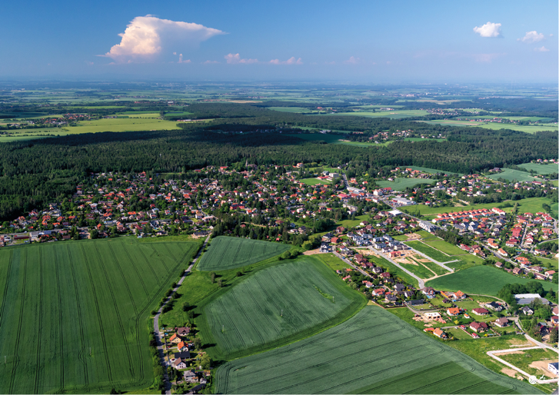
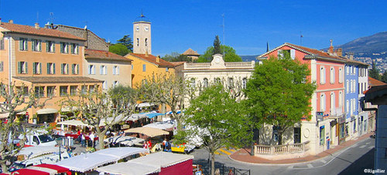
5 Pre-selected villages
Dingle, Ireland
Raudanmaa, Finland
Mukarov, Czech Republic
Mouans-Sartoux, France
Kythera, Greece

Slide 4
What is a village?
The Draft EU Definition defines smart villages as ‘communities in rural areas’. It further specifies that “Communities in rural areas can include one or several human settlements, without any restrictions regarding the number of habitants.”
No restrictions on the number of inhabitants means that ‘larger’ rural municipalities – including smaller rural towns - can also fall within the ‘smart village’ concept.

Slide 5
What is a village?
Furthermore, the importance of joint planning /harmonisation of strategies of neighboring villages has been recognized, therefore, joined up approaches and strategy development of an integrated/ coherent local rural territory can be justified in the context of the Smart Rural project.
It is expected that villages will not be selected only from predominantly rural areas (according to the OECD or EUROSTAT definition).

Slide 6
What is a smart village?
Smart villages are communities in rural areas that develop smart solutions to deal with challenges in their local context.
They build on existing local strengths and opportunities to engage in a process of sustainable development of their territories.
They rely on a participatory approach to develop and implement their strategies to improve their economic, social and environmental conditions…
…in particular by promoting innovation and mobilizing solutions offered by digital technologies.
Smart villages benefit from cooperation and alliances with other communities and actors in rural and urban areas.
The initiation and the implementation of smart village strategies may build on existing initiatives and can be funded by a variety of public and private sources.

Slide 7
How Smart Villages add value?
Innovative new policies & financing
Existing programmes / interventions)
Animation/ cooperation support
Smart Solutions:
Technological, digital & social innovation
Smart Village Strategies
Animation/ cooperation support
LEADER / CLLD LAGS
New emerging partnerships and stakeholder groups
Self-starting groups (villages, group of villages, etc.)
“EIP-RURAL”
(‘public-private-civic + research)
Other…
EIP-AGRI
(‘smart farming’)

Slide 8
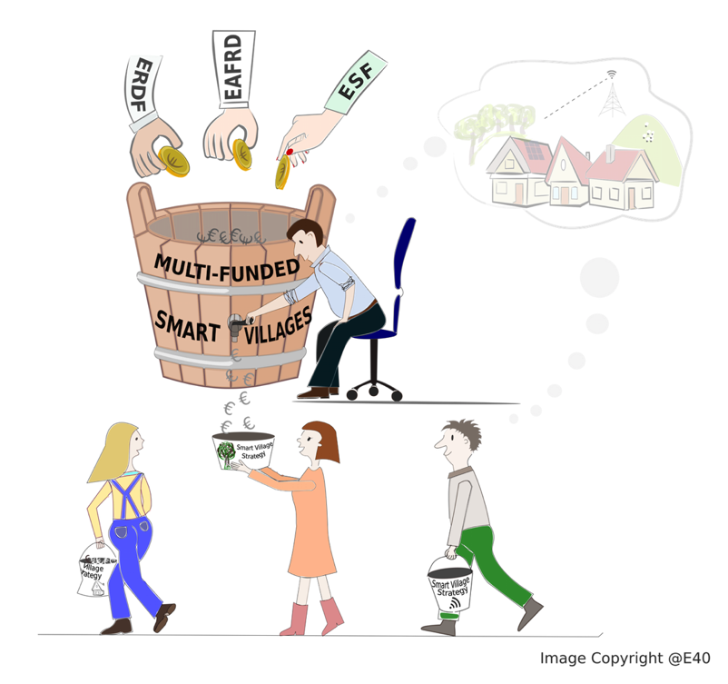
Integrated policy tool
Basic services & village renewal; Cooperation; LEADER …
Infrastructural investments; CLLD; Interreg;
URBACT…
(Digital) skills development; capacity-building; social inclusion…
Experimentation for innovation

Slide 9
Call for villages to participate in smart village incubation program

Slide 10
Is your village/community/network an ideal candidate?
Ideal candidate:
✓ Needs support, ideas and inspiration to become a smart village
✓ Has enthusiastic leaders who are committed to develop and implement a smart village strategy
✓ Has the relevant human capacity to mobilise for the smart village process
✓ Would benefit from specific expert guidance to progress with village development plans

Slide 11
Is your village/community/network an ideal candidate?
Ideal candidate:
✓ Ideally has some basic technical capacity, including sufficient broadband connectivity or relevant infrastructure (e.g. community spaces) – although this is not a pre-condition.
✓ Ideally has some initial ideas, flagship projects or planning activities done that the smart village process can build on – although this is not a pre-condition.
✓ Is open to knowledge exchange and cooperation with other villages and stakeholders

Slide 12
What do I need to do to apply?
You need to complete a simple application form describing:
✓ The key characteristics, challenges, assets and opportunities of your village
✓ The motivation to become a smart village
✓ The added value that you expect from becoming a participant village and the support that your village needs
Application form will be made available soon at www.smartrural21.eu

Slide 13
What will I get from the smart village program?
If your village is selected the project will:
✓ Provide specialist expert support for strategy development & implementation
✓ Allow your village to visit and get inspiration from other villages
✓ Allow your village to take part in exchange and capacity building with other participant villages through the Smart Village Academy events
✓ Promote your village and give visibility in European-level discussions and exchanges

Slide 14
Selection criteria of applications
✓ Level of motivation and human capacity
✓ Level of technical & physical development
✓ Expected added value for the village
✓ Integrated approach and innovation potential
✓ Intention to cooperate and readiness to exchange and knowledge-sharing
✓ Level of transferability

Slide 15
What is innovation?
Innovation ‘Smart’ ultimately has to bring innovation to rural areas to support local communities finding new or alternative solutions for addressing their challenges.
Innovation can not only come from new approaches and solutions; but also from the engagement of new stakeholders, partnerships, cooperation and co-creation processes; new ways of working and new forms of governance and funding (e.g. crowd-funding).
It is important that smart village strategies consider future (mega)trends (such as technological/ digital developments or climate change) that influence the future of local development of communities – either as challenges or opportunities.
Villages will be encouraged to think about ‘out of the box’ solutions to achieve a breakthrough in the village’s life and development.

Slide 16
What is innovation?
There are (at least) three types of innovation that are highly relevant for the rural development/ smart villages context: digital innovation; other technological innovation; and social innovation.
In particular, digital and technological innovation can offer new opportunities and can be crucial driver of change for smart villages – subject to sufficient broadband connectivity.
Social innovation has been identified as one of the main tools for addressing social challenges and strengthening social cohesion in local communities. Social innovation concerns both social goals – e.g. developing new innovative tools, approaches or products to improve basic services, supporting elderly people or engaging young people – a social processes – i.e. new types of collaboration, engagement of new stakeholders, or new ways of working with local stakeholders.
Social innovation might have particular relevance in lagging behind communities.

Slide 17
The process and deadlines
26.03.2020 – launch the public call for applications through e-mail list, websites, information letters and FB of Ministry of Rural Affairs, NRN, Estonian LEADER Union, Village Movement, Ministry of Social Affairs
05.05.2020 - submission deadline for applications of villages https://form.jotformeu.com/E40/smart-rural-application It is expected 5-15 applications per country;

Slide 18
The process and deadlines
15.05.2020 – selection of villages by national selection commission. National selection commission consists of national expert, representatives of Ministry of Rural Affairs, Ministry of Social Affairs, NRN, Estonian LEADER Union, Village Movement;
29.05.2020 – selection of 12 villages by international expert group

Slide 19
Contact us
Estonian national expert
Kristiina Tammets (LAG Tartu County Development Association)
kristiina@tas.ee
Mob. 53409873

Slide 20
International team contacts
Edina Ocsko (Project Coordinator, E40)
edina.ocsko@e40.eu
Ed Thorpe (Communications Manager, E40)
ed.thorpe@e40.eu

